Slide 1
Lecture 6:
An introduction to non-parametric tests
PSYC234: Statistics: from association to modelling causality
Dr Amy Atkinson
Lecturer in Developmental Psychology
amy.atkinson@lancaster.ac.uk

Slide 2
Learning objectives
To understand what non-parametric tests are and when they are appropriate
To understand how to check whether the assumption of normality is met when the data consists of two independent groups or two related samples
To understand the theory behind Wilcoxon rank-sum test and the Wilcoxon signed-rank test
To understand how to run the Wilcoxon rank-sum test and Wilcoxon signed-rank test in R

Slide 3
The plan
My aim: to add a few final statistical tests to your toolbox for when the statistical test you’ve learned about might not be appropriate
A situation where unrelated samples t-test and related samples t-test are not appropriate
Lecture 6
Non-parametric tests

Slide 4
Part 1
What are non-parametric tests and when should they be used?

Slide 5
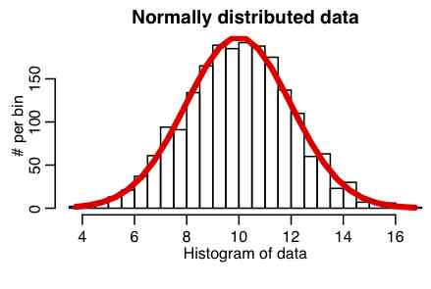
Parametric tests
T-tests and ANOVAs are parametric tests
  Rely on the assumption that the data comes from a normally distribution population
What if the assumption of normality is violated?
  You can conduct non-parametric tests
Non-parametric tests are more flexible:
  Data does not need to come from a normally distributed population

Slide 6
How do non-parametric tests work?
Parametric tests calculate the test statistic (e.g. F, t) using values of the dependent variable
Most non-parametric tests do not use the values of the dependent variable
Group (independent variable) | Dependent variable
1 | 23
1 | 31
2 | 2
2 | 4

Slide 7
How do non-parametric tests work?
Parametric tests calculate the test statistic (e.g. F, t) using values of the dependent variable
Most non-parametric tests do not use the values of the dependent variable
Instead, the data is ranked using the values of the dependent variable (lowest value = 1)
Analysis then carried out on the ranks
Group (independent variable) | Dependent variable | Rank
1 | 23 | 3
1 | 31 | 4
2 | 2 | 1
2 | 4 | 2

Slide 8

Why not just always perform non-parametric tests?
Type I Error
False positive
Type II Error
False negative
Non-parametric tests have less statistical power
Non-parametric tests more likely to result in Type II error (relative to parametric tests)

